Slide 1
Deep Learning
Detection & Segmentation
Artem Chumachenko

Slide 2
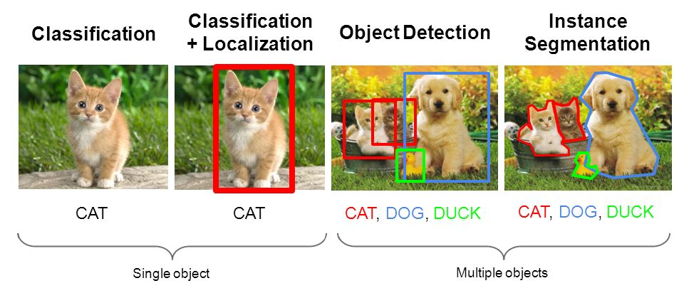
Multiple Objects

Slide 3
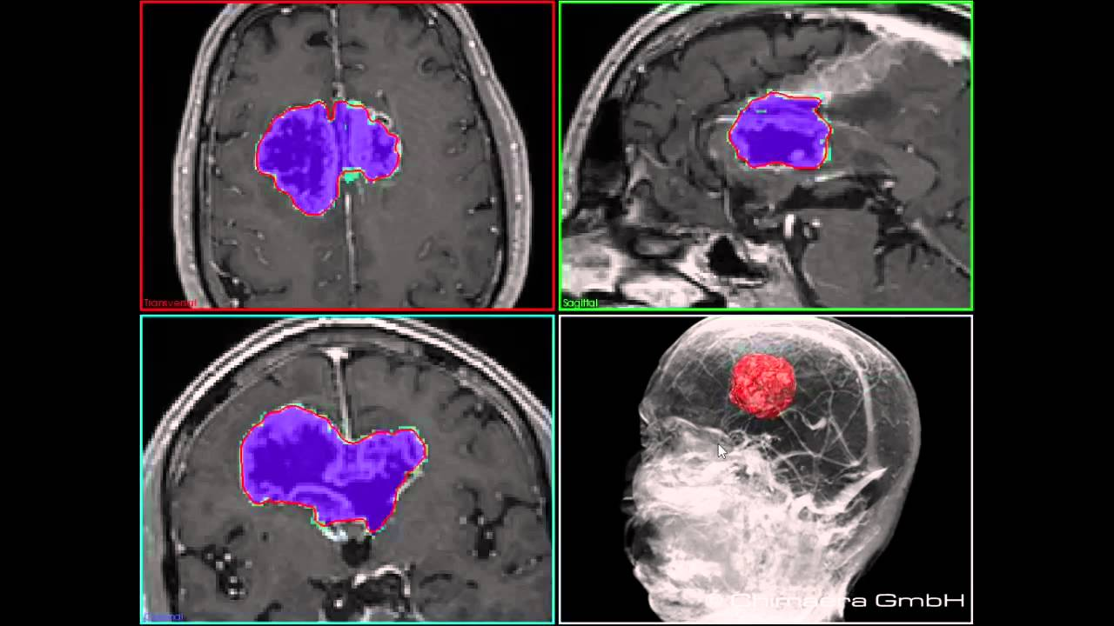
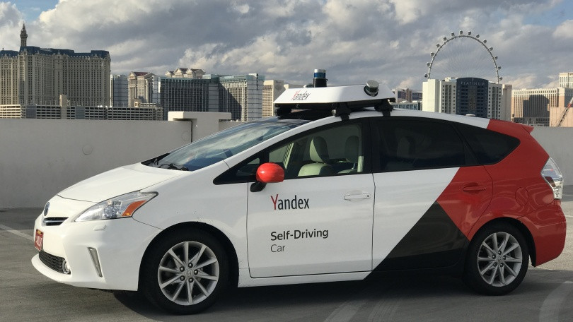
Application
Self-driving cars
Medical images
CCTV
OCR

Slide 4
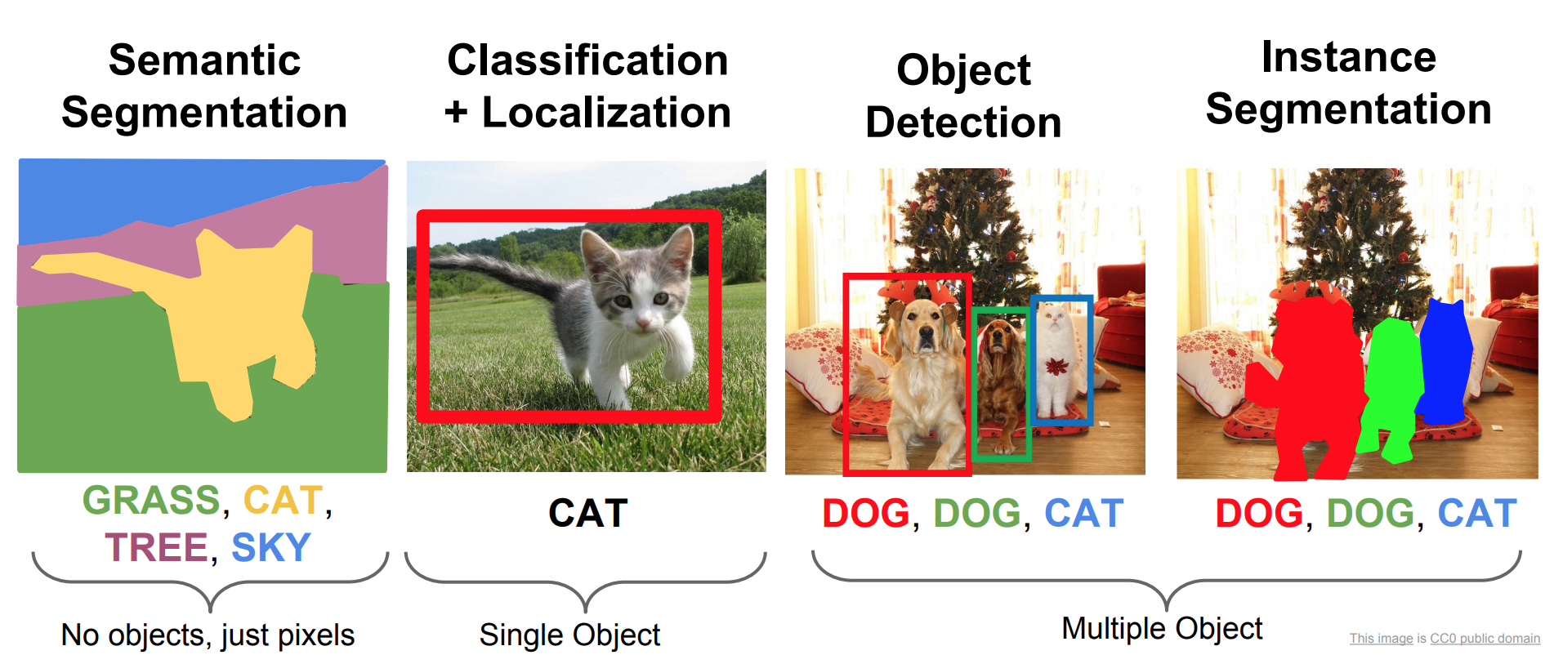
Difference

Slide 5
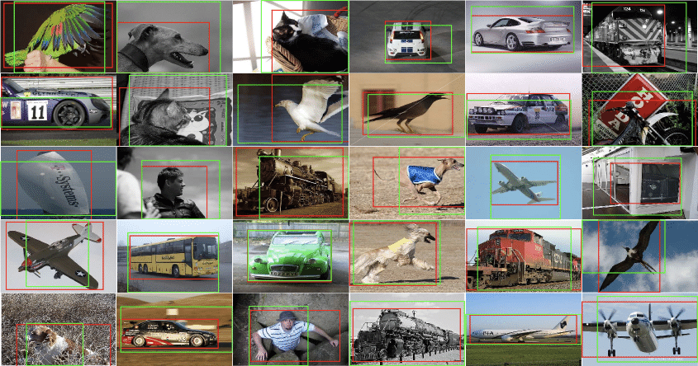
Datasets
PASCAL
COCO
ILSVRC

Slide 6
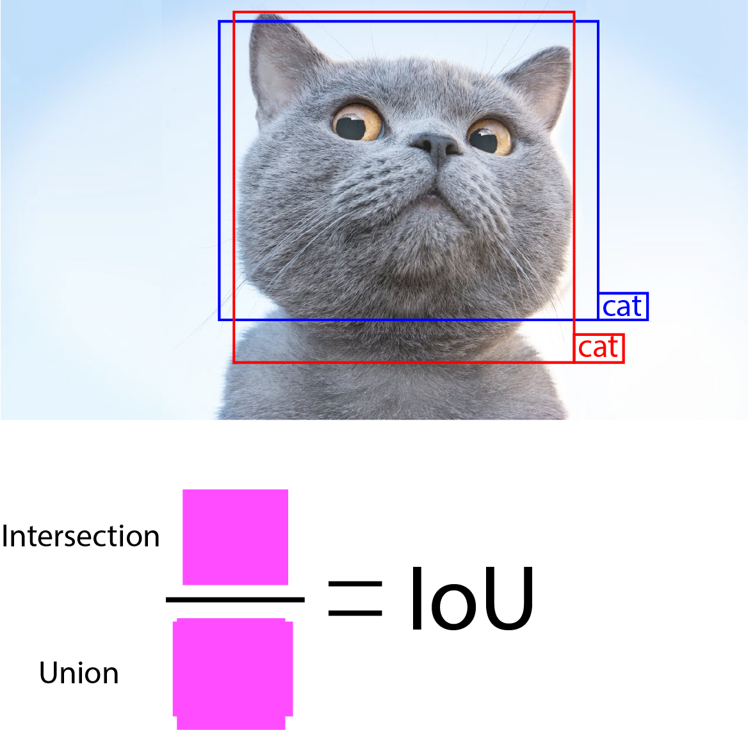
Metrics

Slide 7
Metrics. IoU

Slide 8
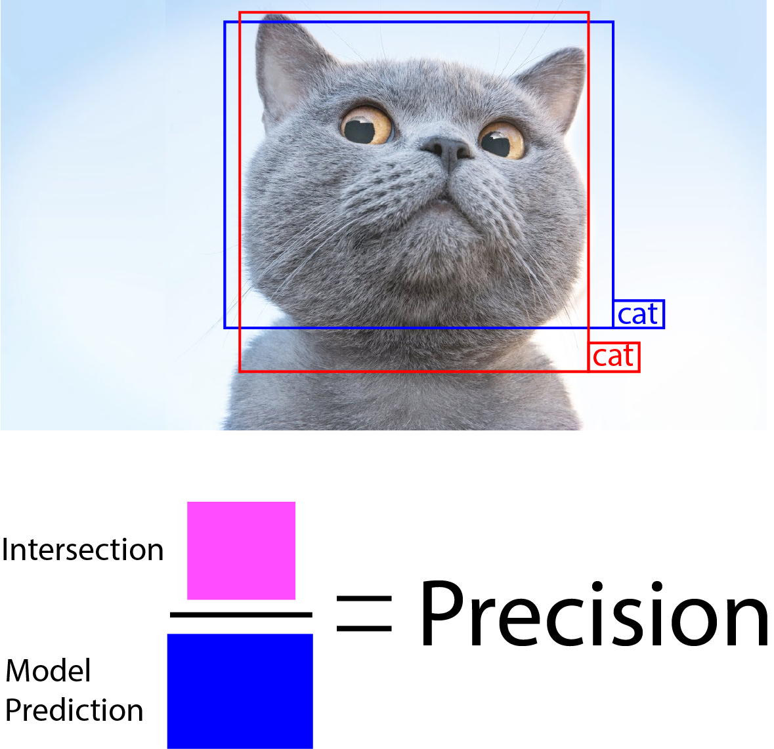
Metrics. Dice

Slide 9
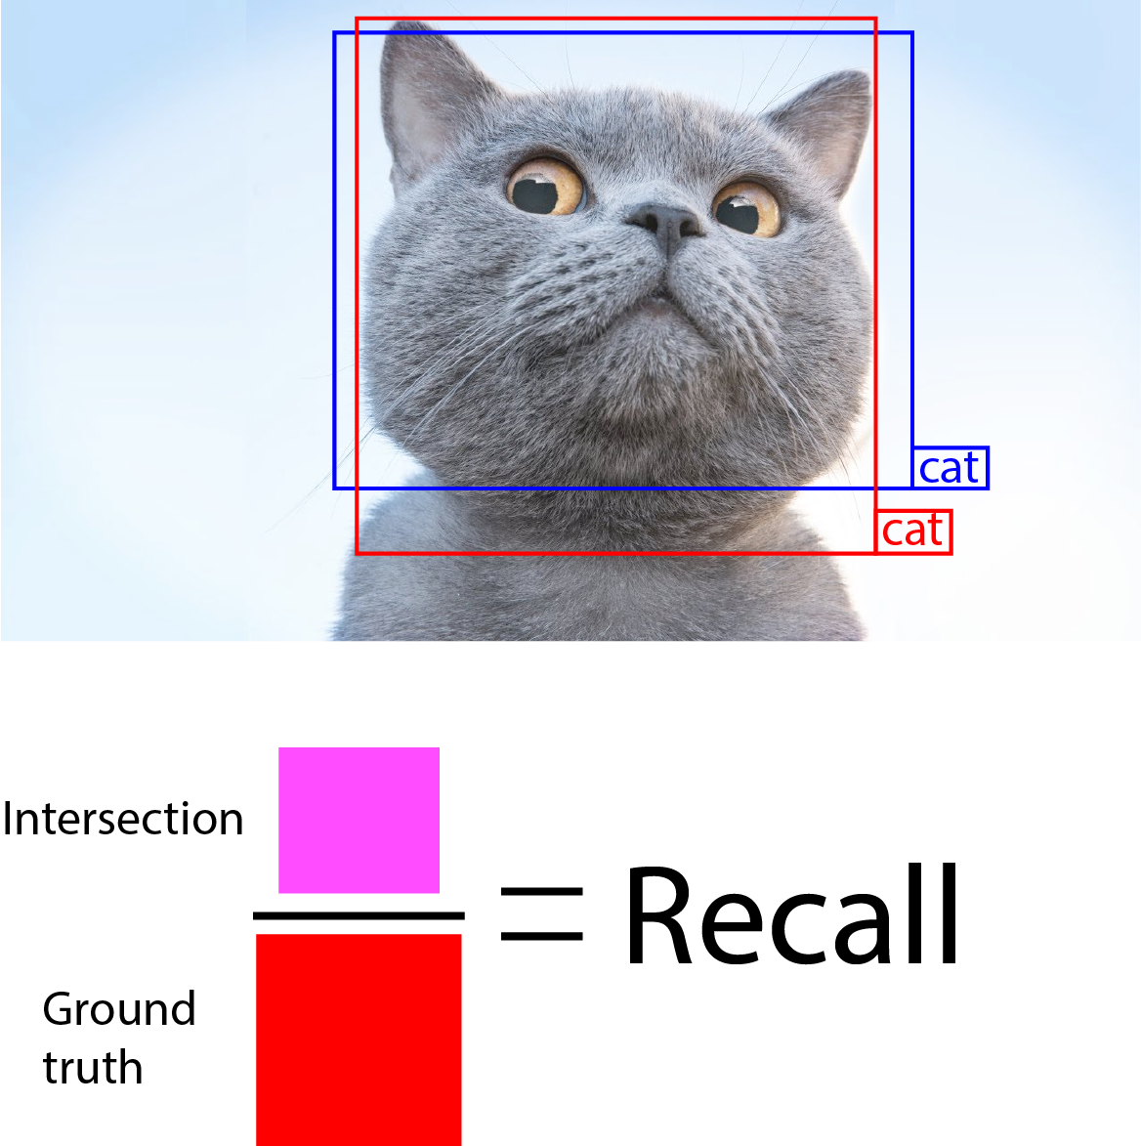
Metrics. Dice

Slide 10
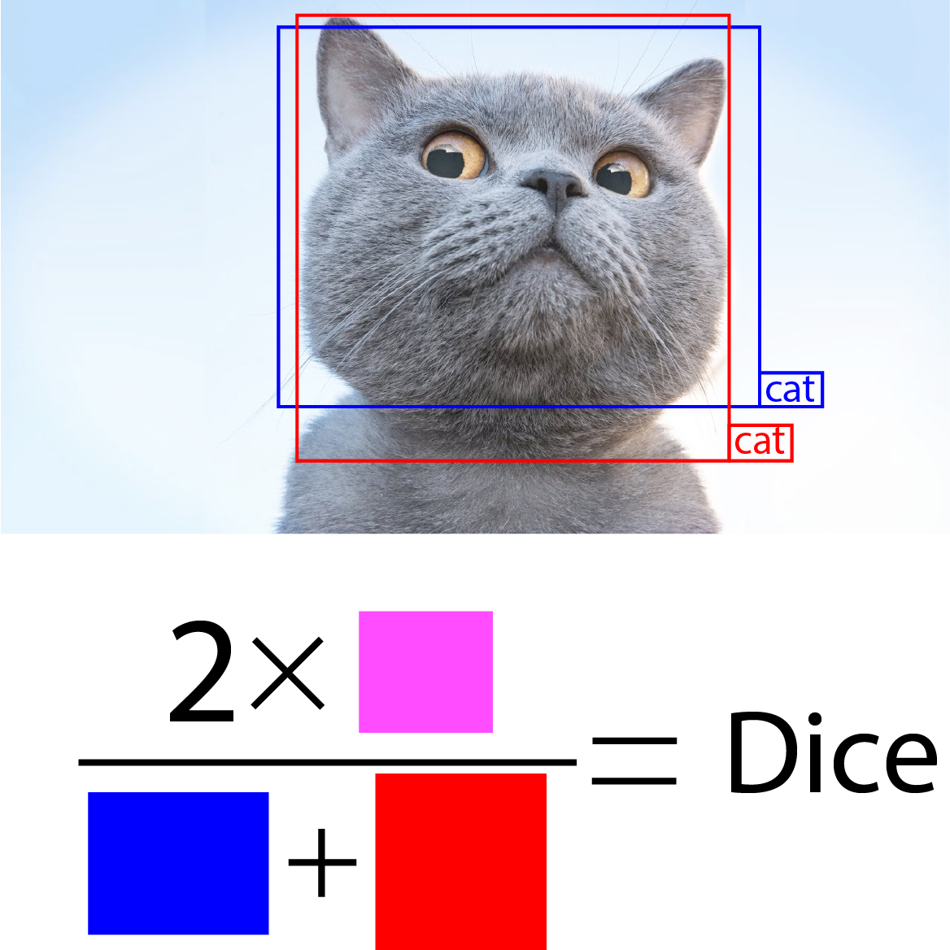
Metrics. Dice

Slide 11
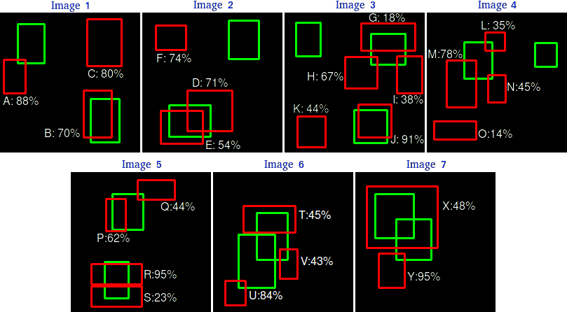
Metrics. mAP

Slide 12
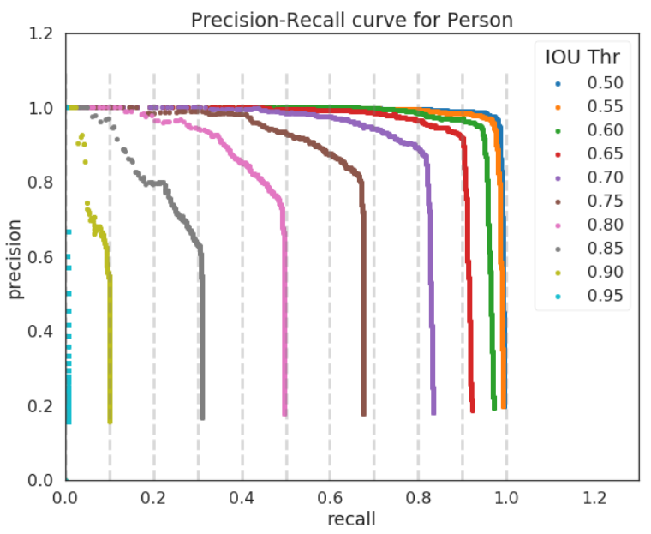
Metrics. mAP

Slide 13
Model Zoo
Object Detection
RCNN
Fast, Faster RCNN
YoLo (v1-v5)
SSD
FPN, RetinaNet
CenterNet
CornerNet
ExtremeNet
etc
Image Segmentation
Mask RCNN
DeepMask
TensorMask
UNet
SegNet
DeepLab
Attention based
etc

Slide 14
Object Detection History
RCNN - Two stage
Fast, Faster RCNN -Two Stage
YoLo (v1-v5) - One Stage
SSD - One Stage
FPN, RetinaNet - One Stage
CenterNet - Anchor Free
CornerNet - Anchor Free
ExtremeNet - Anchor Free
etc

Slide 15
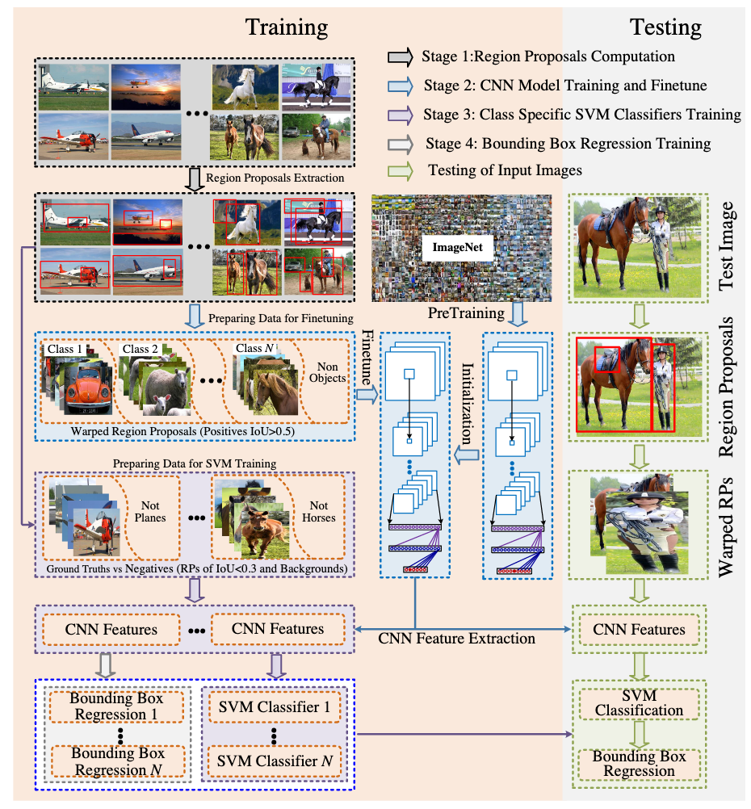
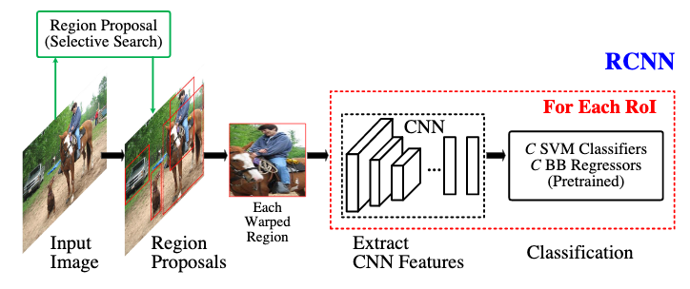
RCNN

Slide 16
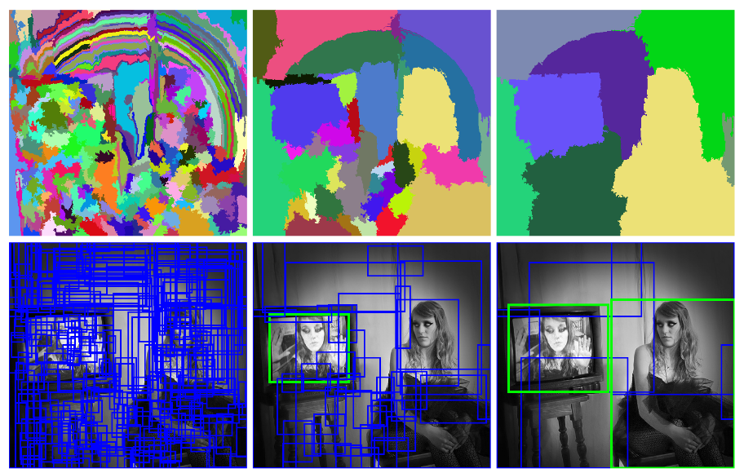
RCNN. Selective Search

Slide 17
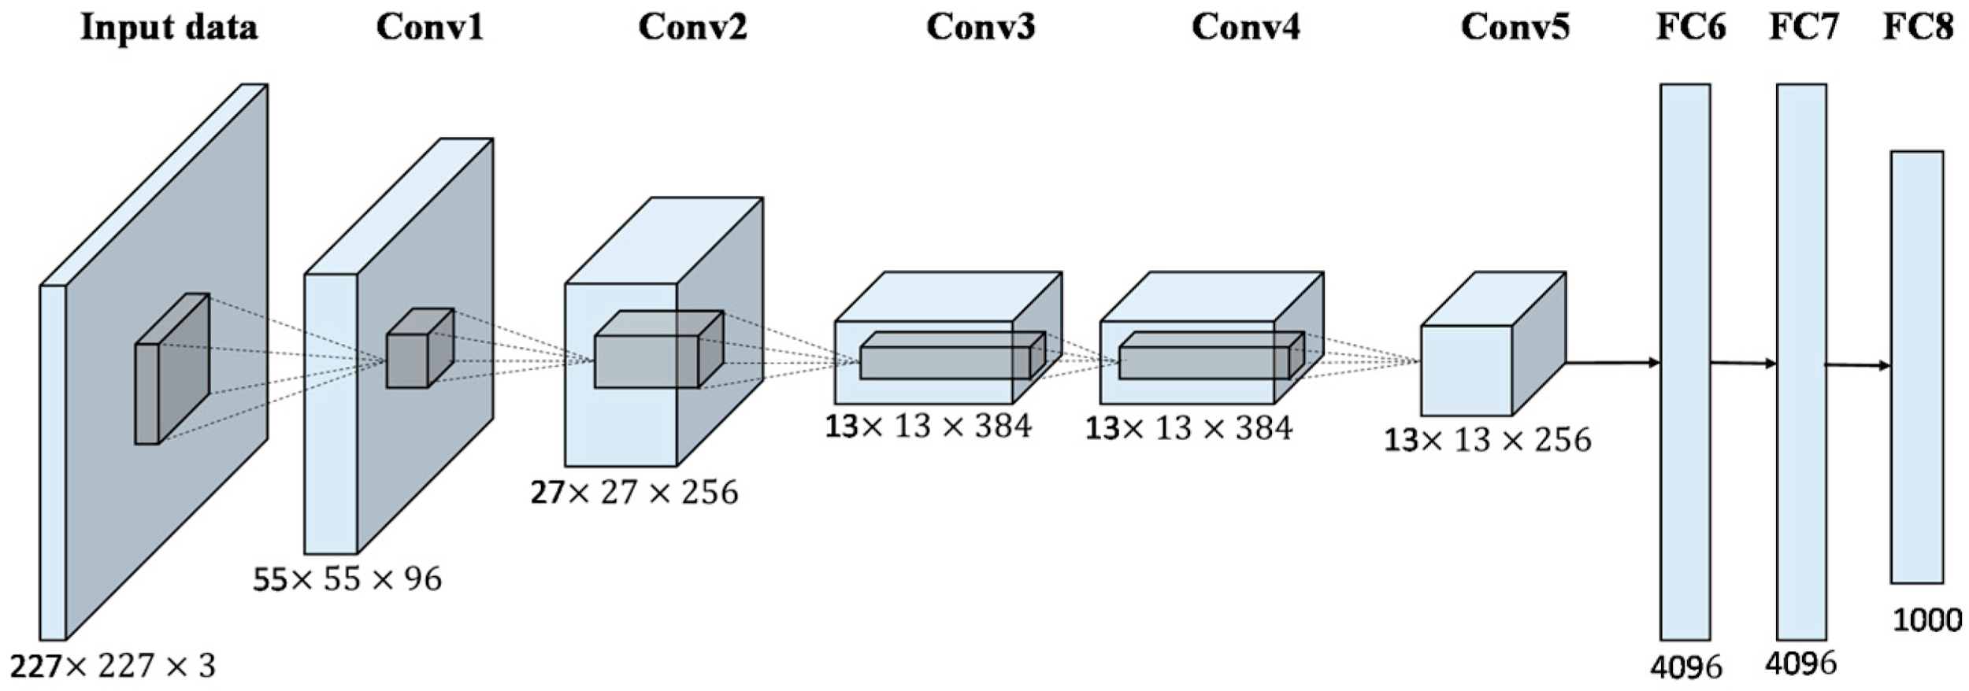
RCNN. Feature Extraction

Slide 18
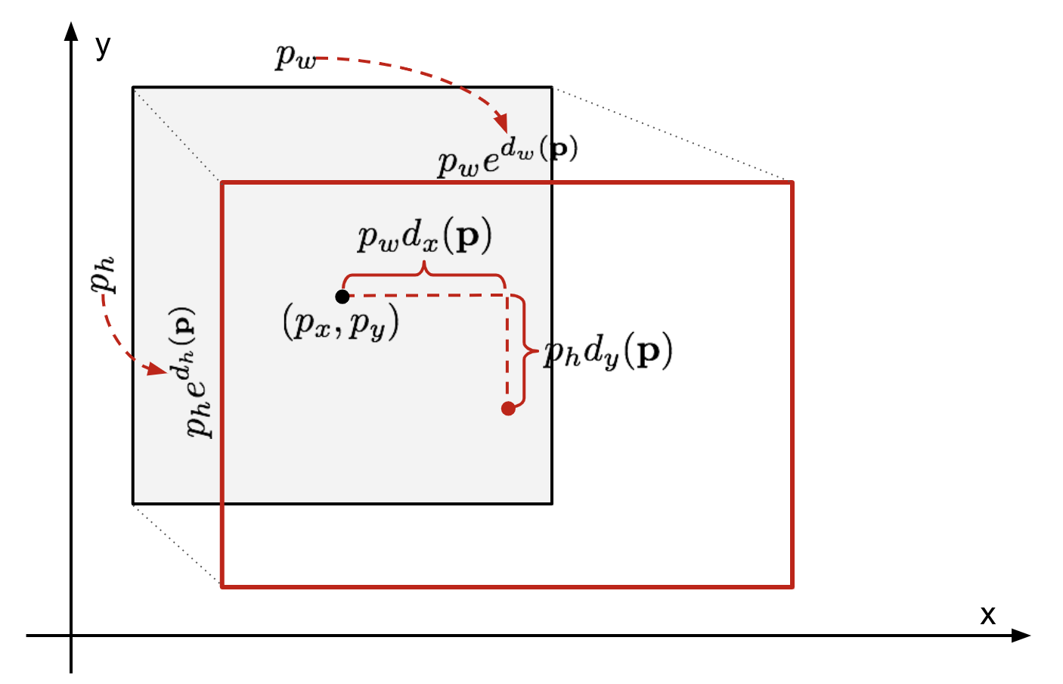
RCNN. SVM & BB Regressor

Slide 19
RCNN

Slide 20
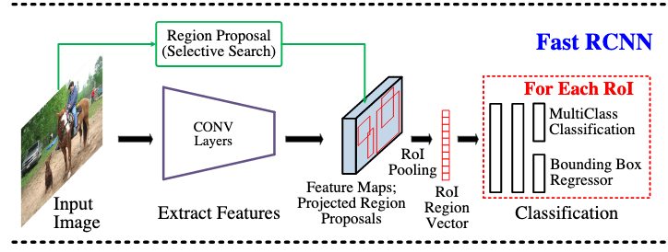
Fast RCNN

Slide 21
Fast RCNN. Feature Map Projection

Slide 22
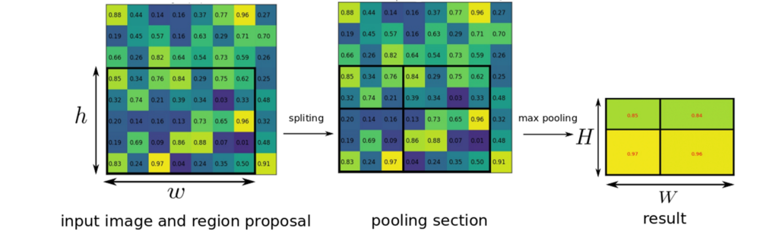
Fast RCNN. RoI

Slide 23
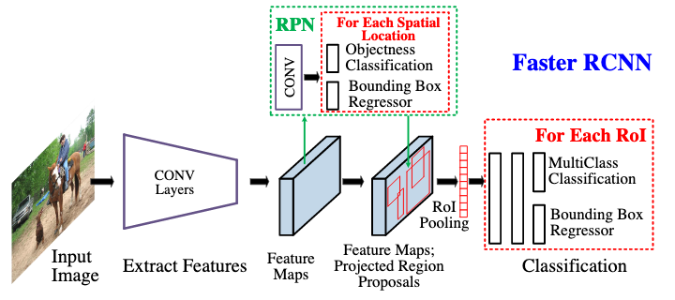
Faster RCNN

Slide 24
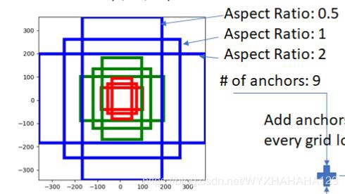
Faster RCNN. Anchor

Slide 25
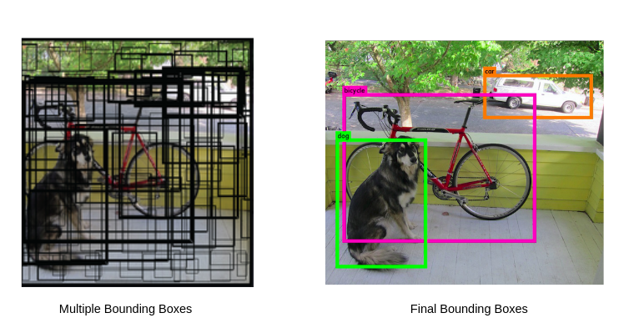
Bounding Boxes

Slide 26
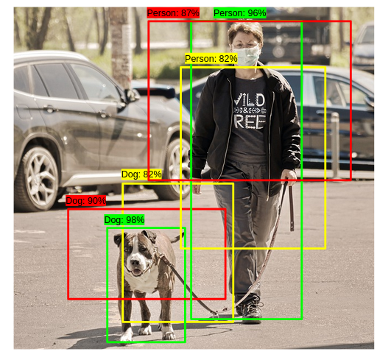
Bounding Boxes. Non-max

Slide 27
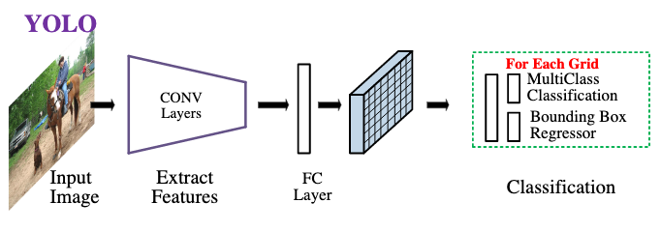
YOLO

Slide 28
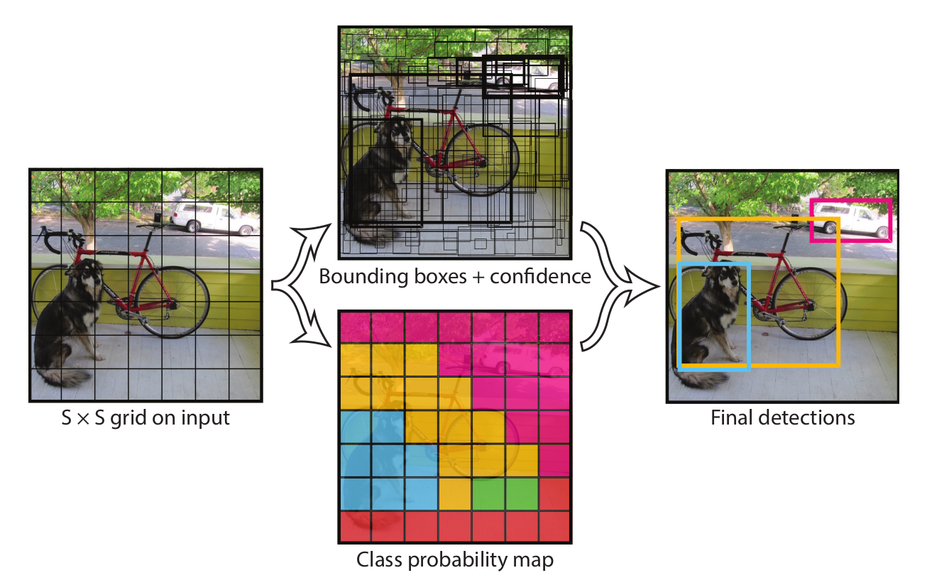
YOLO. Grid

Slide 29
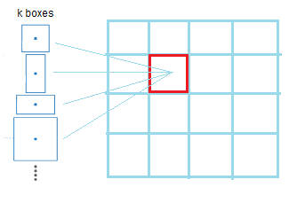
YOLO v2

Slide 30
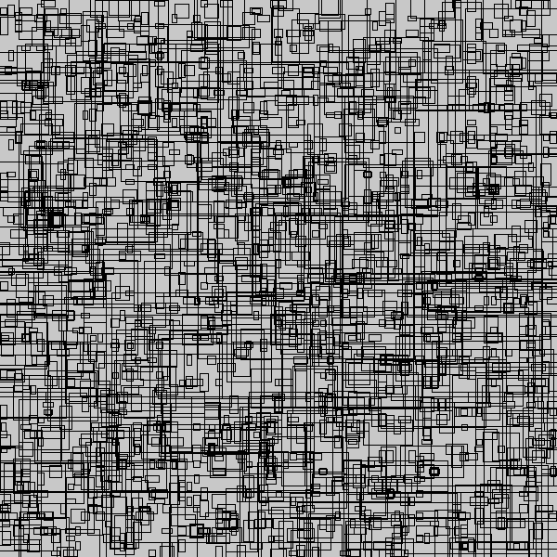
YOLO v2. “Good” anchor boxes

Slide 31
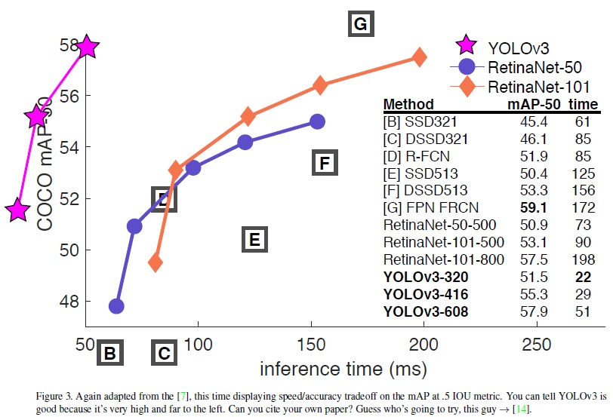
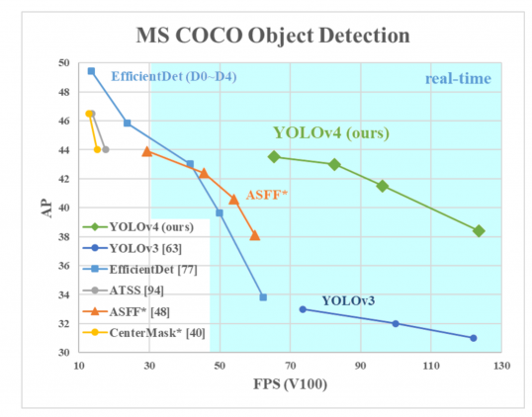
YOLO v3,4,(5)

Slide 32
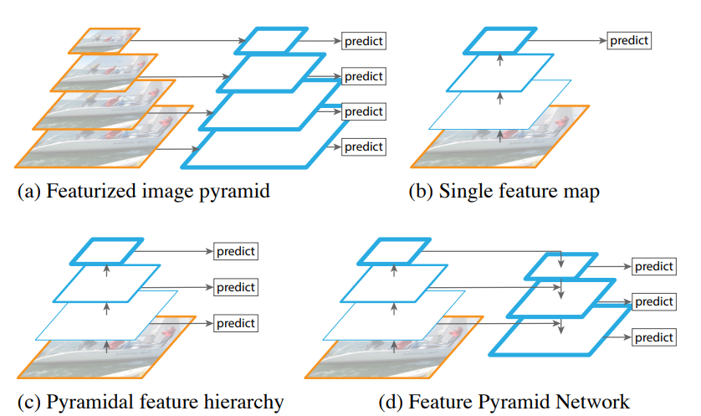
Feature Pyramid Network

Slide 33
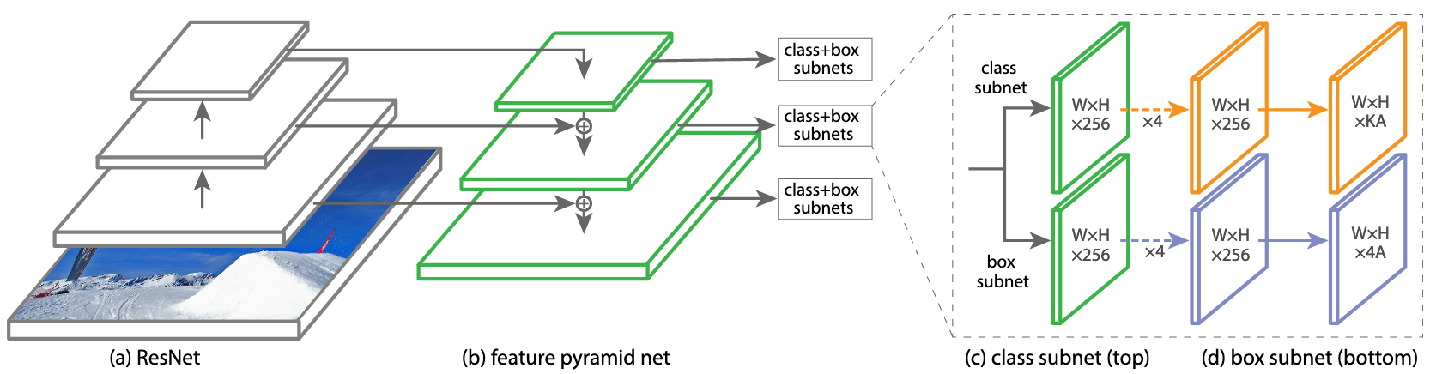
RetinaNet

Slide 34
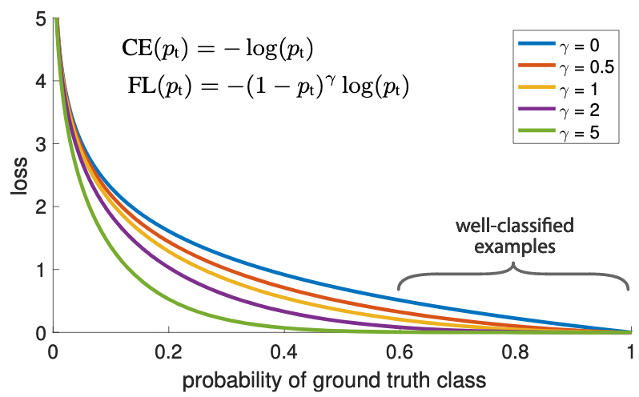
RetinaNet. Focal Loss

Slide 35
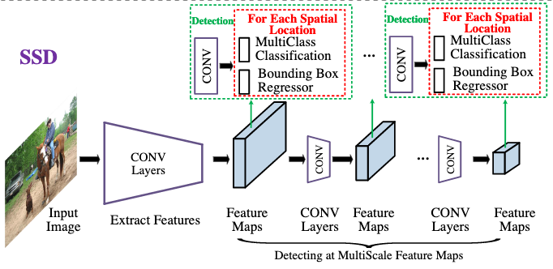
SSD

Slide 36
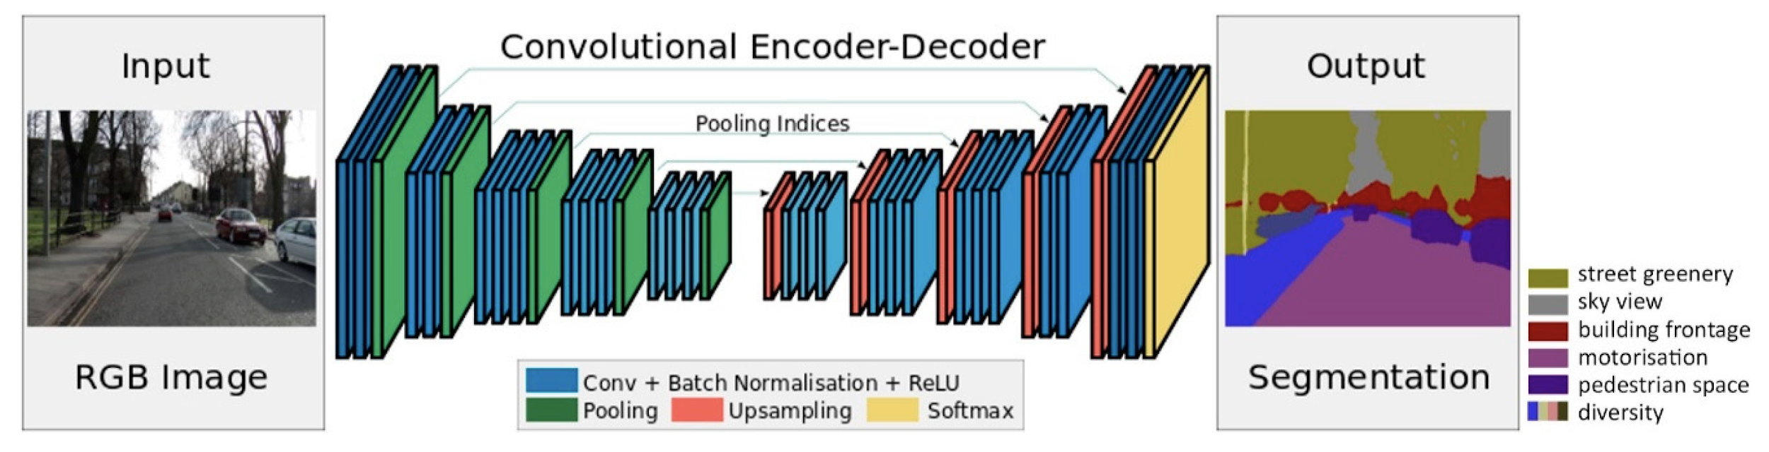
SegNet

Slide 37
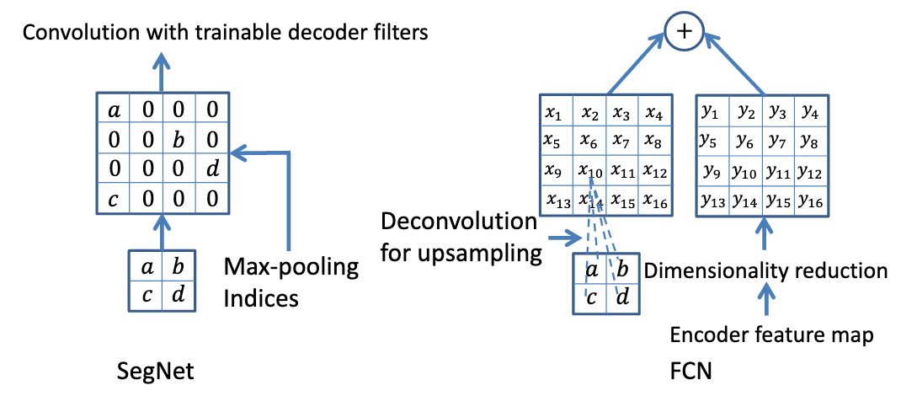
SegNet. Upsampling

Slide 38
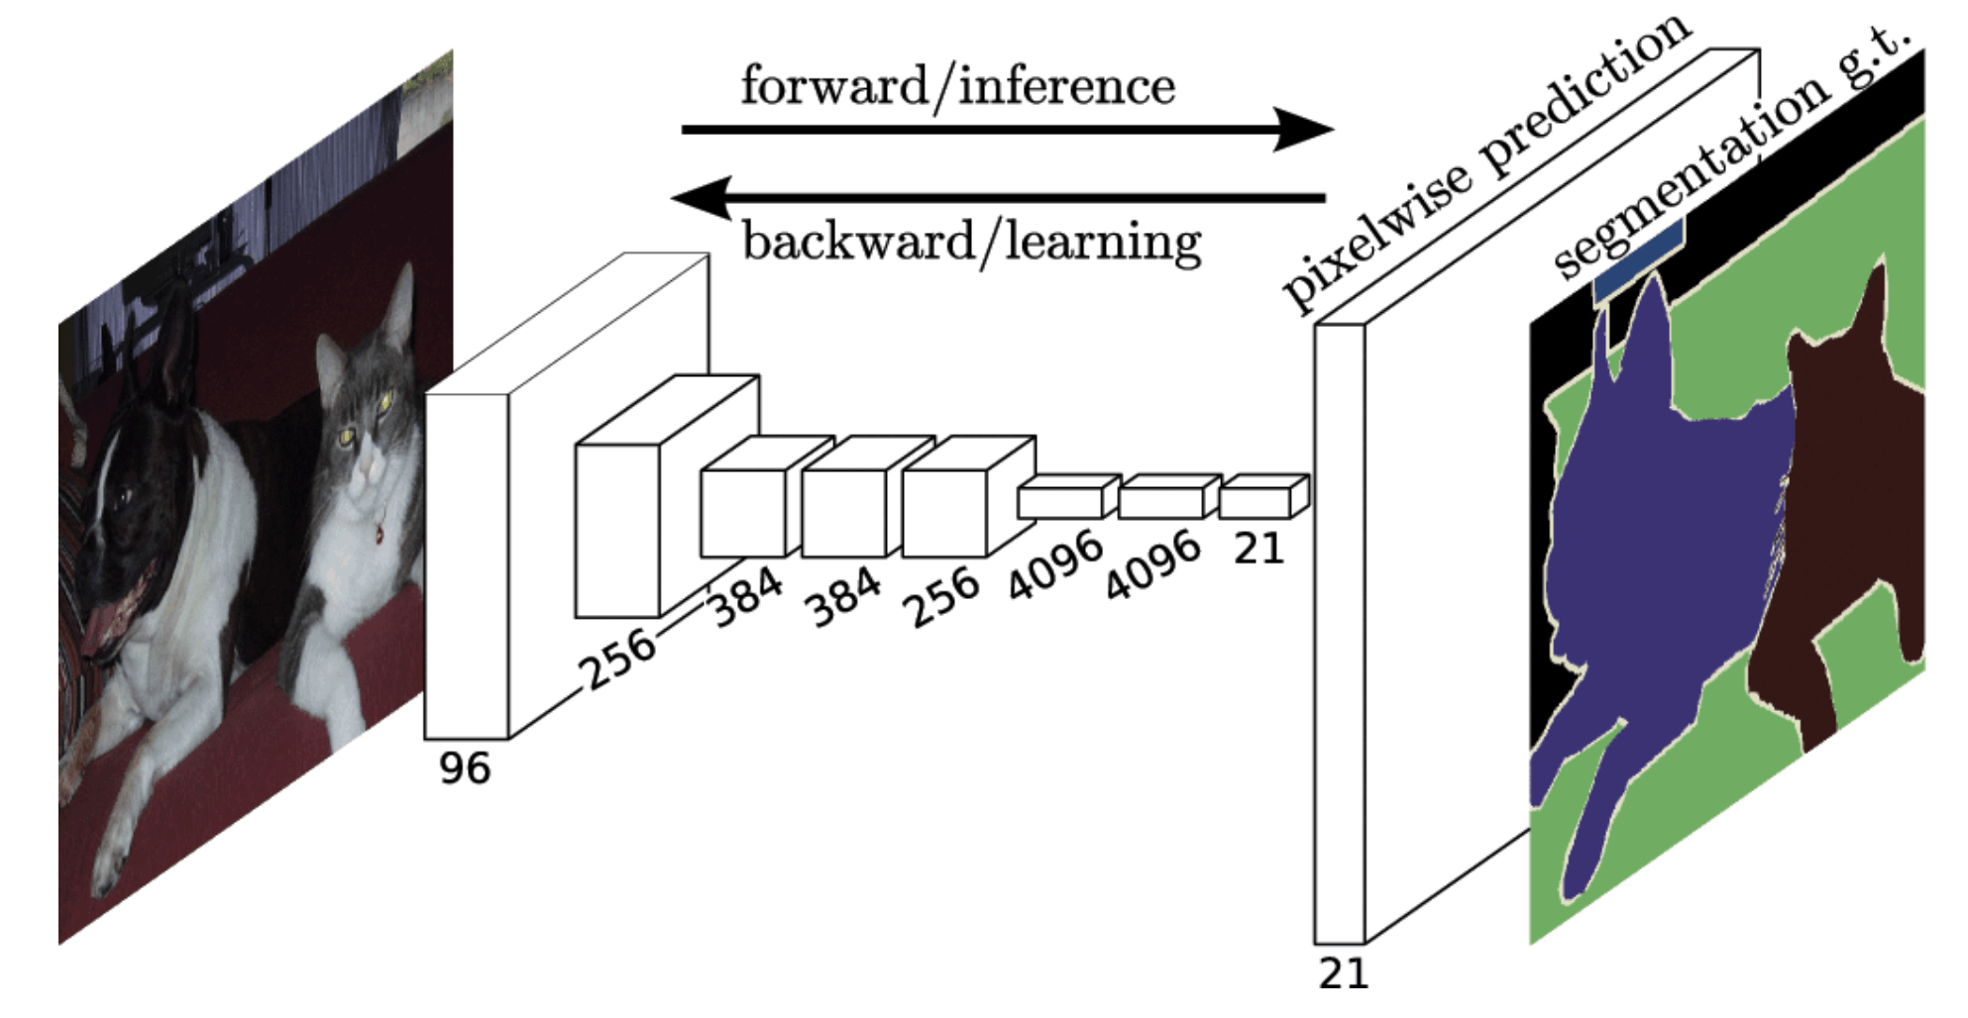
FCN

Slide 39
FCN. Deconvolution

Slide 40
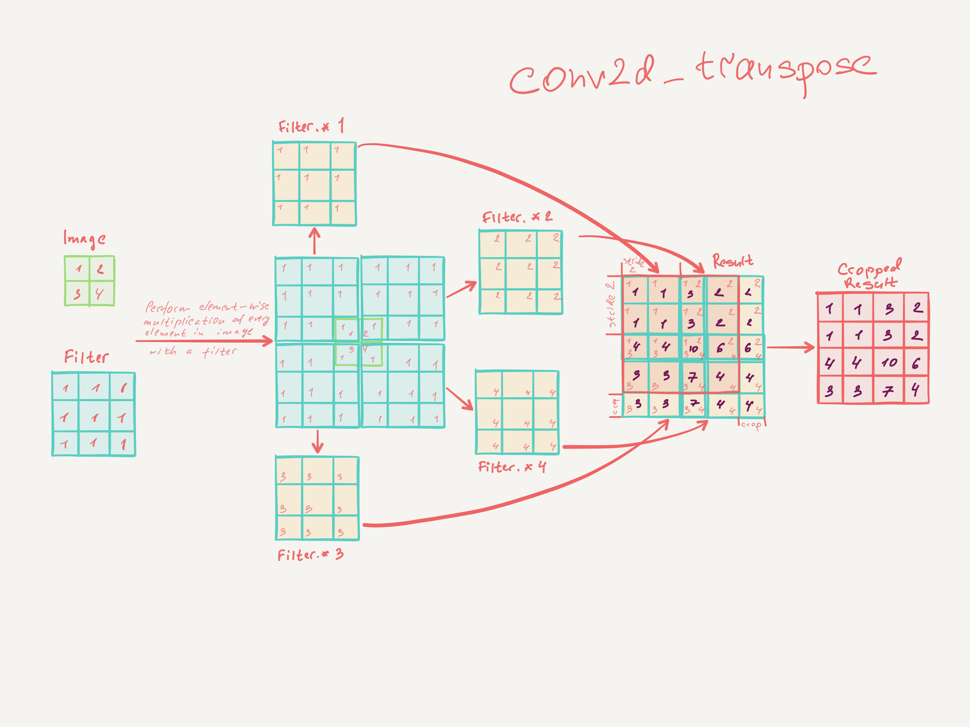
FCN. Deconvolution

Slide 41
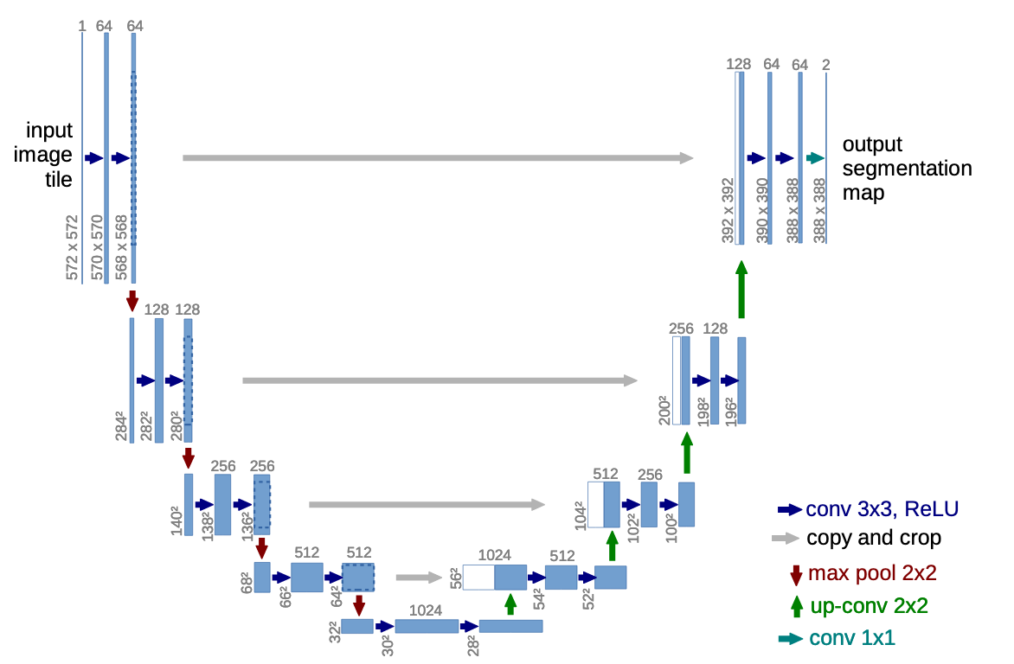
UNet

Slide 42
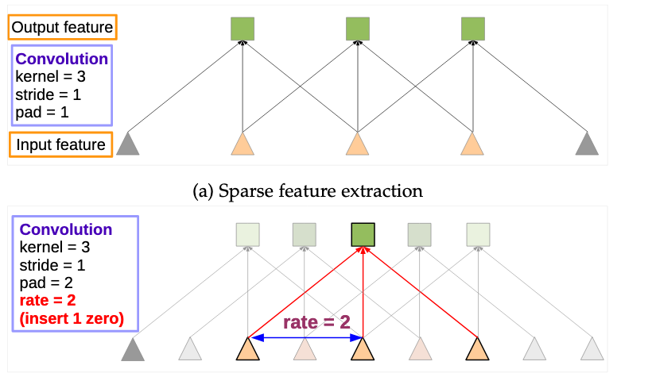
Extra ideas. Dilated convolution
Dilated convolution

Slide 43
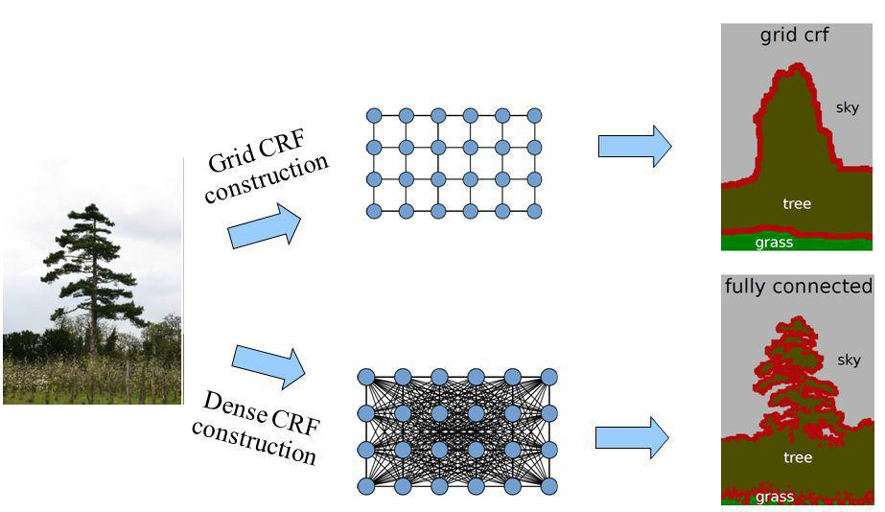
Extra ideas. CRF
Dilated convolution
CRF

Slide 44
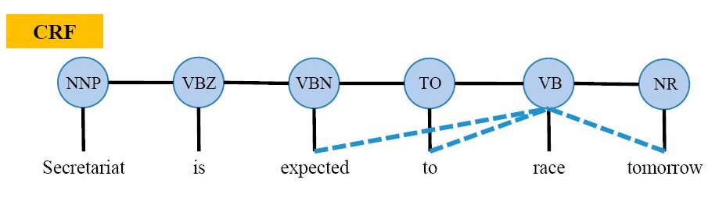
Extra ideas. CRF
Dilated convolution
CRF

Slide 45
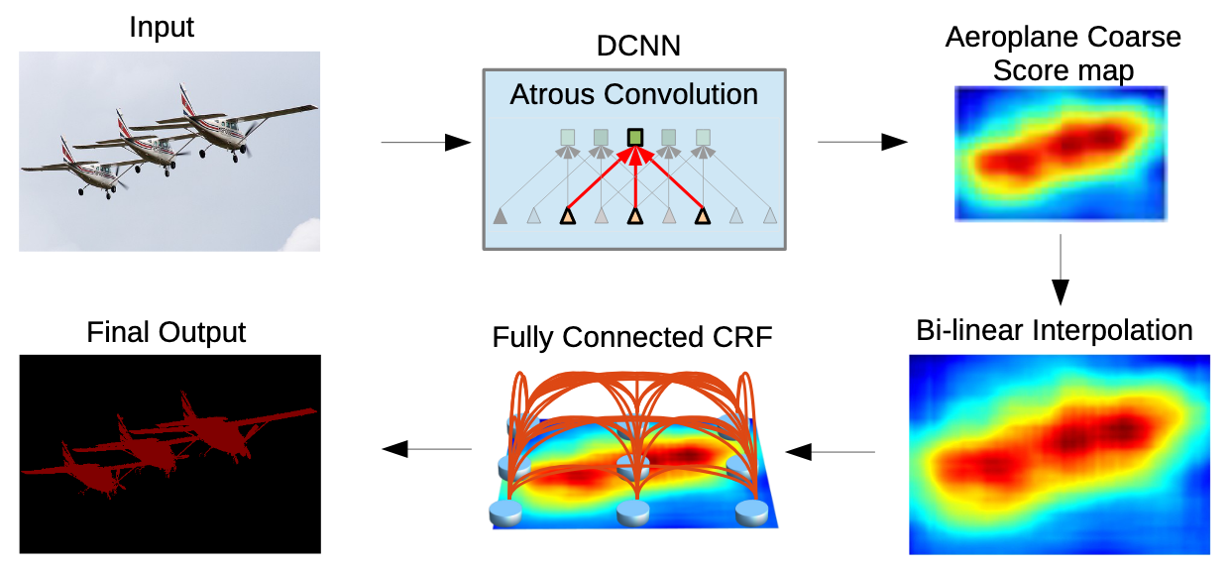
DeepLab

Slide 46
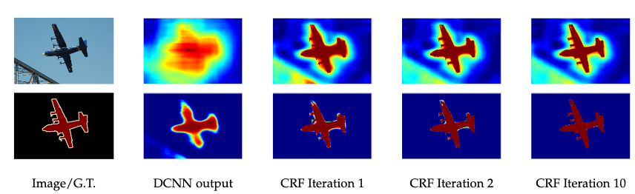
DeepLab

Slide 47
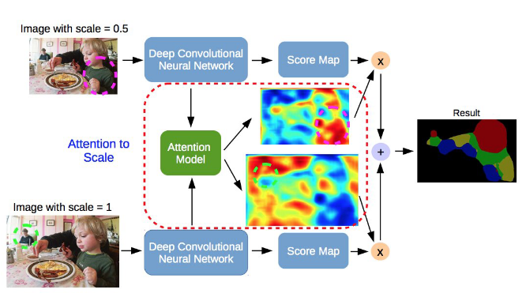
Extra ideas. Attention
Dilated convolution
CRF
Attention

Slide 48
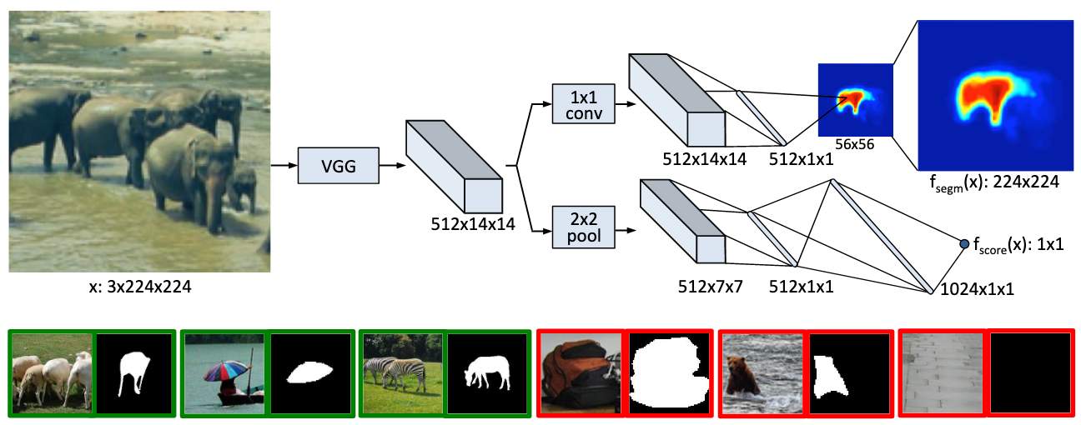
DeepMask

Slide 49
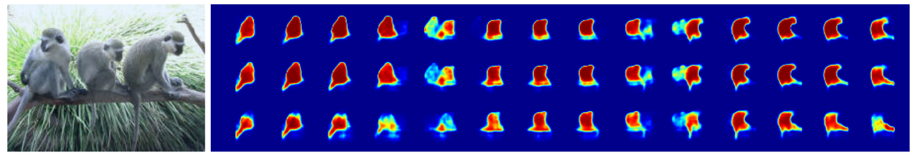
DeepMask

Slide 50
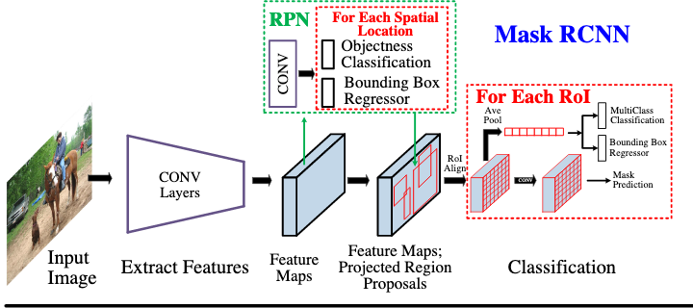
Mask RCNN

Slide 51
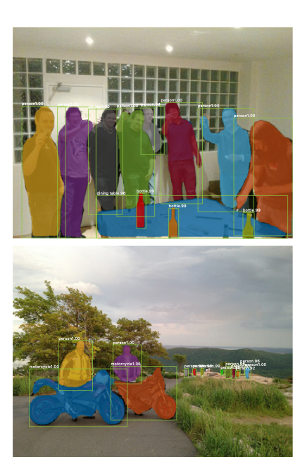
Mask RCNN vs Faster RCNN

Slide 52
Anchor Free

